Slide 1
First-Order Logic

Slide 2
As an output, we will represent the meaning of natural language expressions by translating them into first-order logic.
Not all of natural language semantics can be expressed in first-order logic.
But it is a good choice for computational semantics because it is expressive enough to represent many aspects of semantics,
and on the other hand,
there are excellent systems available off the shelf for carrying out automated inference in first-order logic.
Syntax:
First-order logic keeps all the Boolean operators of propositional logic, but it adds some important new mechanisms.
To start with, propositions are analyzed into predicates and arguments, which takes us a step closer to the structure of natural languages.
The standard construction rules for first-order logic recognize terms such as individual variables and individual constants, and predicates that take differing numbers of arguments.

Slide 3
For example,
Angus walks might be formalized as walk(angus).
Angus sees Bertie as see(angus, bertie).
We will call walk a unary predicate, and see a binary predicate.

Slide 4
First-order logic has nothing substantive to say about lexical semantics
although some theories of lexical semantics can be encoded in first-order logic.
Whether an atomic predication like see(angus, bertie) is true or false in a situation is not a matter of logic,
but depends on the particular valuation that we have chosen for the constants see, angus, and bertie.
For this reason, such expressions are called non-logical constants. By contrast, logical constants (such as the Boolean operators) always receive the same interpretation in every model for first-order logic.

Slide 5
It is often helpful to inspect the syntactic structure of expressions of first-order logic,
and the usual way of doing this is to assign types to expressions.
Following the tradition of Montague grammar,
we will use two basic types: e is the type of entities, while t is the type of formulas,
i.e., expressions that have truth values.
Given these two basic types, we can form complex types for function expressions.
〈σ, τ〉 can also be written as 〈e, t〉
A binary predicate has type 〈e, 〈e, t〉〉.

Slide 6
In first-order logic, arguments of predicates can also be individual variables such as x, y, and z.
In NLTK, we adopt the convention that variables of type e are all lowercase.
Individual variables are similar to personal pronouns like he, she, and it, in that we need to know about the context of use in order to figure out their denotation.
we can construct an open formula with two occurrences of the variable x.
a. He is a dog and he disappeared.
b. dog(x) & disappear(x)
By placing an existential quantifier ∃x (“for some x”) in front of above ex, we can bind these variables,
a. ∃x.(dog(x) & disappear(x))
b. At least one entity is a dog and disappeared.
c. A dog disappeared.

Slide 7
In addition to the existential quantifier, first-order logic offers us the universal quantifier ∀x (“for all x”),
a. ∀x.(dog(x) → disappear(x))
b. Everything has the property that if it is a dog, it disappears.
c. Every dog disappeared.
all x.(dog(x) -> disappear(x))
Ex:
((exists x. dog(x)) -> bark(x))
all x.((exists x. dog(x)) -> bark(x))

Slide 8
Summarizing the Language of First-Order Logic:
To restate our earlier syntactic rules for propositional logic and add the formation rules for quantifiers;
together, these give us the syntax of first order logic.
In addition, we make explicit the types of the expressions involved.
We’ll adopt the convention that 〈en, t〉 is the type of a predicate that combines with n arguments of type e to yield an expression of type t. In this case, we say that n is the arity of the predicate.
1. If P is a predicate of type 〈en, t 〉, and α1, ... αn are terms of type e, then
P(α1, ... αn) is of type t.
2. If α and β are both of type e, then (α = β) and (α != β) are of type t.
3. If φ is of type t, then so is -φ.
4. If φ and ψ are of type t, then so are (φ & ψ), (φ | ψ), (φ -> ψ), and (φ <-> ψ).
5. If φ is of type t, and x is a variable of type e, then exists x.φ and all x.φ are of type t.

Slide 9
The Semantics of English Sentences

Slide 10
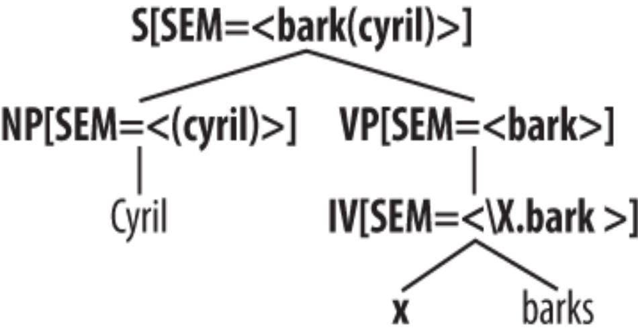
This time, rather than constructing an SQL query, we will build a logical form. One of our guiding ideas for designing such grammars is the Principle of Compositionality.
Principle of Compositionality: the meaning of a whole is a function of the meanings of the parts and of the way they are syntactically combined.
We will assume that the semantically relevant parts of a complex expression are given by a theory of syntactic analysis.
we will take it for granted that expressions are parsed against a context-free grammar.

Slide 11
The SEM value at the root node shows a semantic representation for the whole sentence,
while the SEM values at lower nodes show semantic representations for constituents of the sentence.
Since the values of SEM have to be treated in a special manner, they are distinguished from other feature values by being enclosed in angle brackets.

Slide 12
The λ-Calculus:
“the set of all w such that w is an element of V (the vocabulary) and w has property P”.
{w | w ∈ V & P(w)}
We do this with the λ-operator:
λw. (V(w) & P(w))

Slide 13
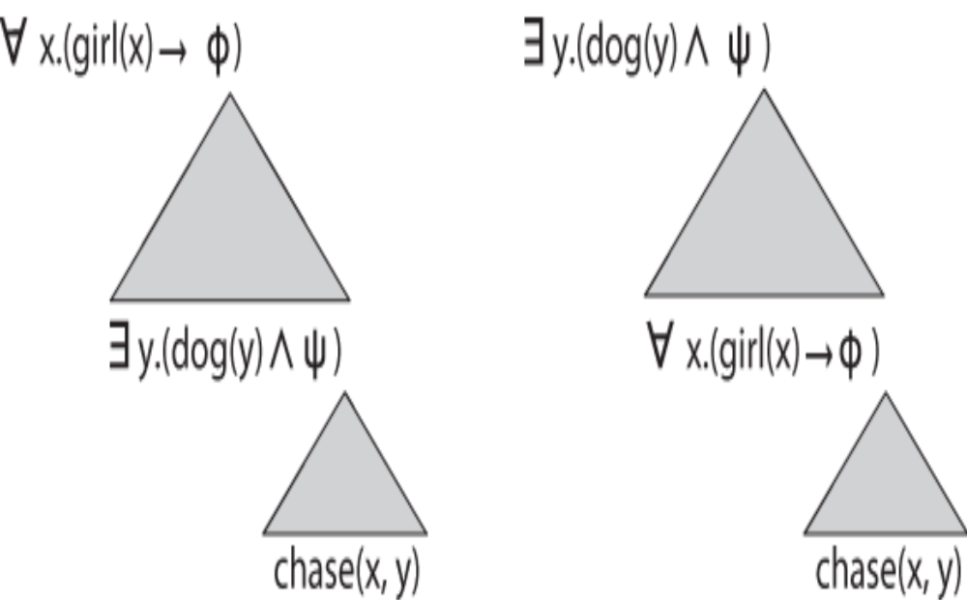
Quantifier scopings:

